Slide 1
Computational Biology: Quiz 1- PANIC!!
(Actually don’t panic – it’s just so we can get to know each other)
QUIZ 1 – Better Know a Classmate
Do this quiz with a partner. Ask them a few things about themselves. Your answers are based on their information.
What is your partner’s name?
What are some of their interests (professional, biological, personal, whatever…)?
Have they ever done any computational biology / bioinformatics before? (assignments for classes count, as do things like running a BLAST search online).
Did they share any worries about the class? If so, what were they most concened about?
Do you see any areas of interest that you might have in common? Is there something you’d like to learn from them?

Slide 2
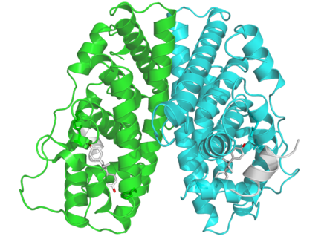
Computational Biology: Overview
Molecules &
Macromolecular Complexes
Source: Estrogen receptor image: https://en.wikipedia.org/wiki/Estrogen_receptor
(e.g. DNA sequence analysis,
protein folding, RNA folding)

Slide 3
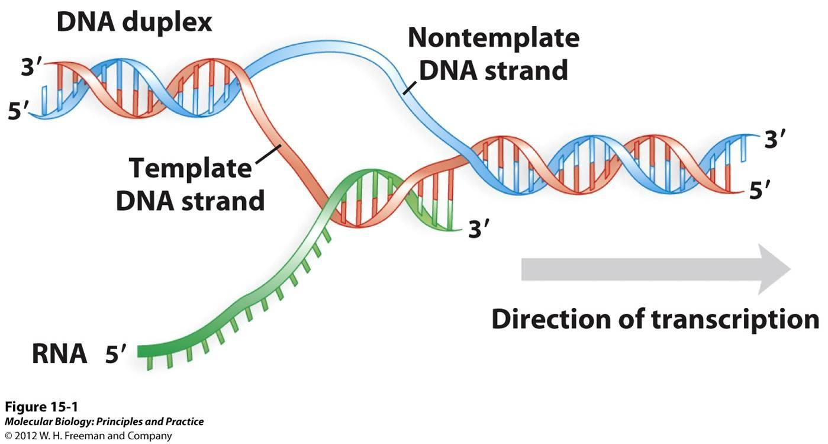
Computational Biology: Overview
Cellular processes & Metabolism
(e.g. Regulation of transcription
and translation, metabolic networks)
Molecules &
Macromolecular Complexes
Source: Estrogen receptor image: https://en.wikipedia.org/wiki/Estrogen_receptor
Txn image: Molecular Biology: Principles and Practice © 2012 W.H Freeman and Company.
(e.g. DNA sequence analysis,
protein folding, RNA folding)

Slide 4
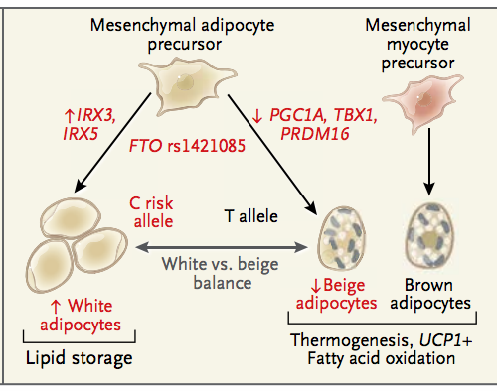
Computational Biology: Overview
Organismal
health or disease
Cellular processes & Metabolism
(e.g. Regulation of transcription
and translation, metabolic networks)
(e.g. development;
Immunity;
modeling neural biology)
Molecules &
Macromolecular Complexes
Source: Estrogen receptor image: https://en.wikipedia.org/wiki/Estrogen_receptor
Txn image: Molecular Biology: Principles and Practice © 2012 W.H Freeman and Company. Adipocyte browning: http://compbio.mit.edu/publications/139_Claussnitzer_NEJM_15.pdf
(e.g. DNA sequence analysis,
protein folding, RNA folding)

Slide 5
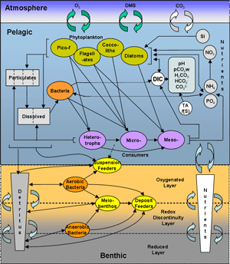
Computational Biology: Overview
Ecosystems
Organismal
health or disease
Cellular processes & Metabolism
(e.g. ecosystem models)
(e.g. Regulation of transcription
and translation, metabolic networks)
(e.g. development;
Immunity;
modeling neural biology)
Molecules &
Macromolecular Complexes
Source: Estrogen receptor image: https://en.wikipedia.org/wiki/Estrogen_receptor
Txn image: Molecular Biology: Principles and Practice © 2012 W.H Freeman and Company. Adipocyte browning: http://compbio.mit.edu/publications/139_Claussnitzer_NEJM_15.pdf Ecosystem model: http://www.meece.eu/library/ersem.html
(e.g. DNA sequence analysis,
protein folding, RNA folding)

Slide 6
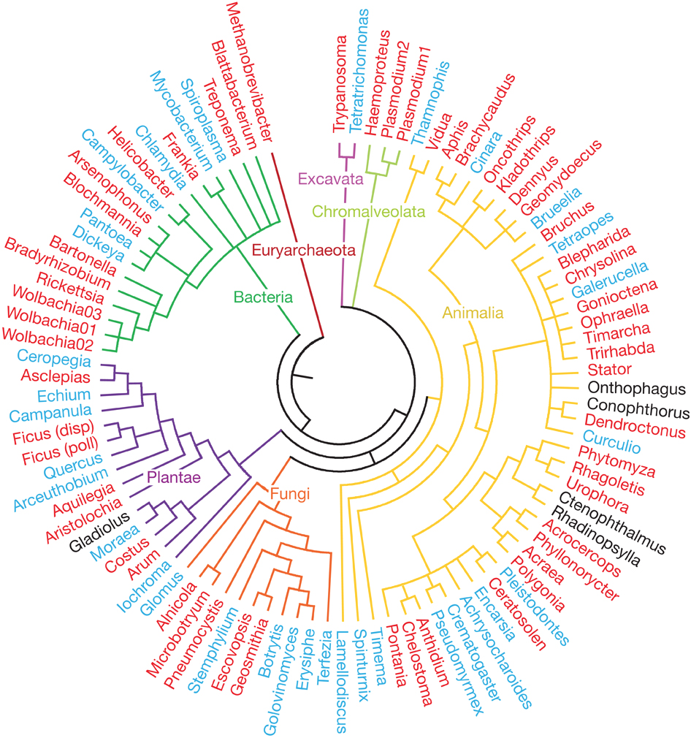
Computational Biology: Overview
Ecosystems
Organismal
health or disease
Cellular processes & Metabolism
(e.g. ecosystem models)
(e.g. Regulation of transcription
and translation, metabolic networks)
(e.g. development;
Immunity;
modeling neural biology)
Evolution
(e.g. Signatures
Of selection;
Phylogeny;
Gene transfer;
Ressurecting
extinct proteins)
Molecules &
Macromolecular Complexes
Source: Estrogen receptor image: https://en.wikipedia.org/wiki/Estrogen_receptor
Txn image: Molecular Biology: Principles and Practice © 2012 W.H Freeman and Company. Adipocyte browning: http://compbio.mit.edu/publications/139_Claussnitzer_NEJM_15.pdf Ecosystem model: http://www.meece.eu/library/ersem.html Phylogeny: Gomez et al., Nature 2010.
(e.g. DNA sequence analysis,
protein folding, RNA folding)

Slide 7
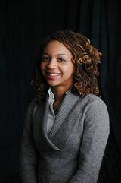
Computational Biology: Overview
Physiological measures of trust in
machine-human interactions
Modeling eye gaze patterns in clinician-patient interaction with lag sequential analysis.
Montague E, Xu J, Chen PY, Asan O, Barrett BP, Chewning B Human factors 2011 Oct; 53(5):502-16 PMID: 22046723
Dr. Enid Montague
Northwestern University

Slide 8
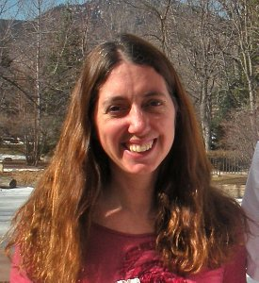
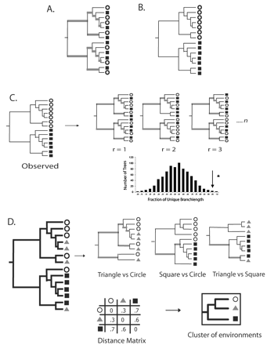
Computational Biology: Overview
Measuring Microbial Diversity
(UniFrac algorithm, and microbiome papers
w/ 27,000 citations)
Dr. Catherine Lozupone

Slide 9
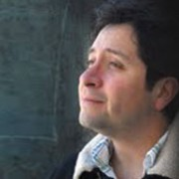
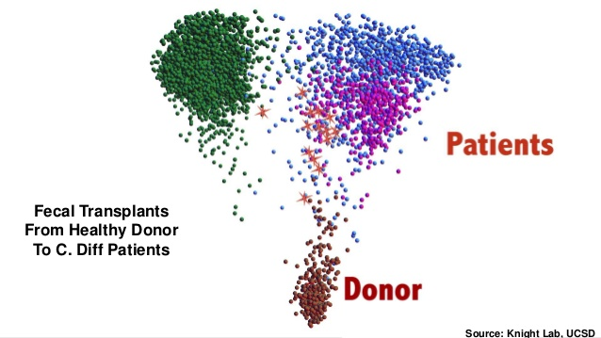
Computational Biology: Overview
Visualizing Large Datasets
(EMPeror; SitePainter)
Dr. Antonio Gonzales Peña

Slide 10
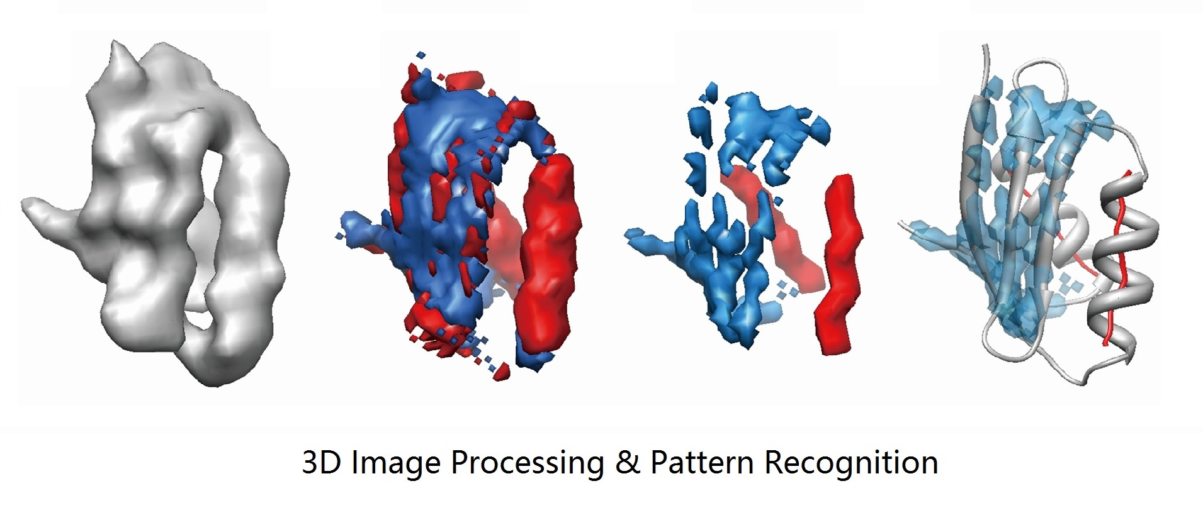
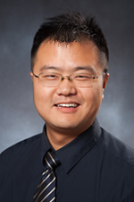
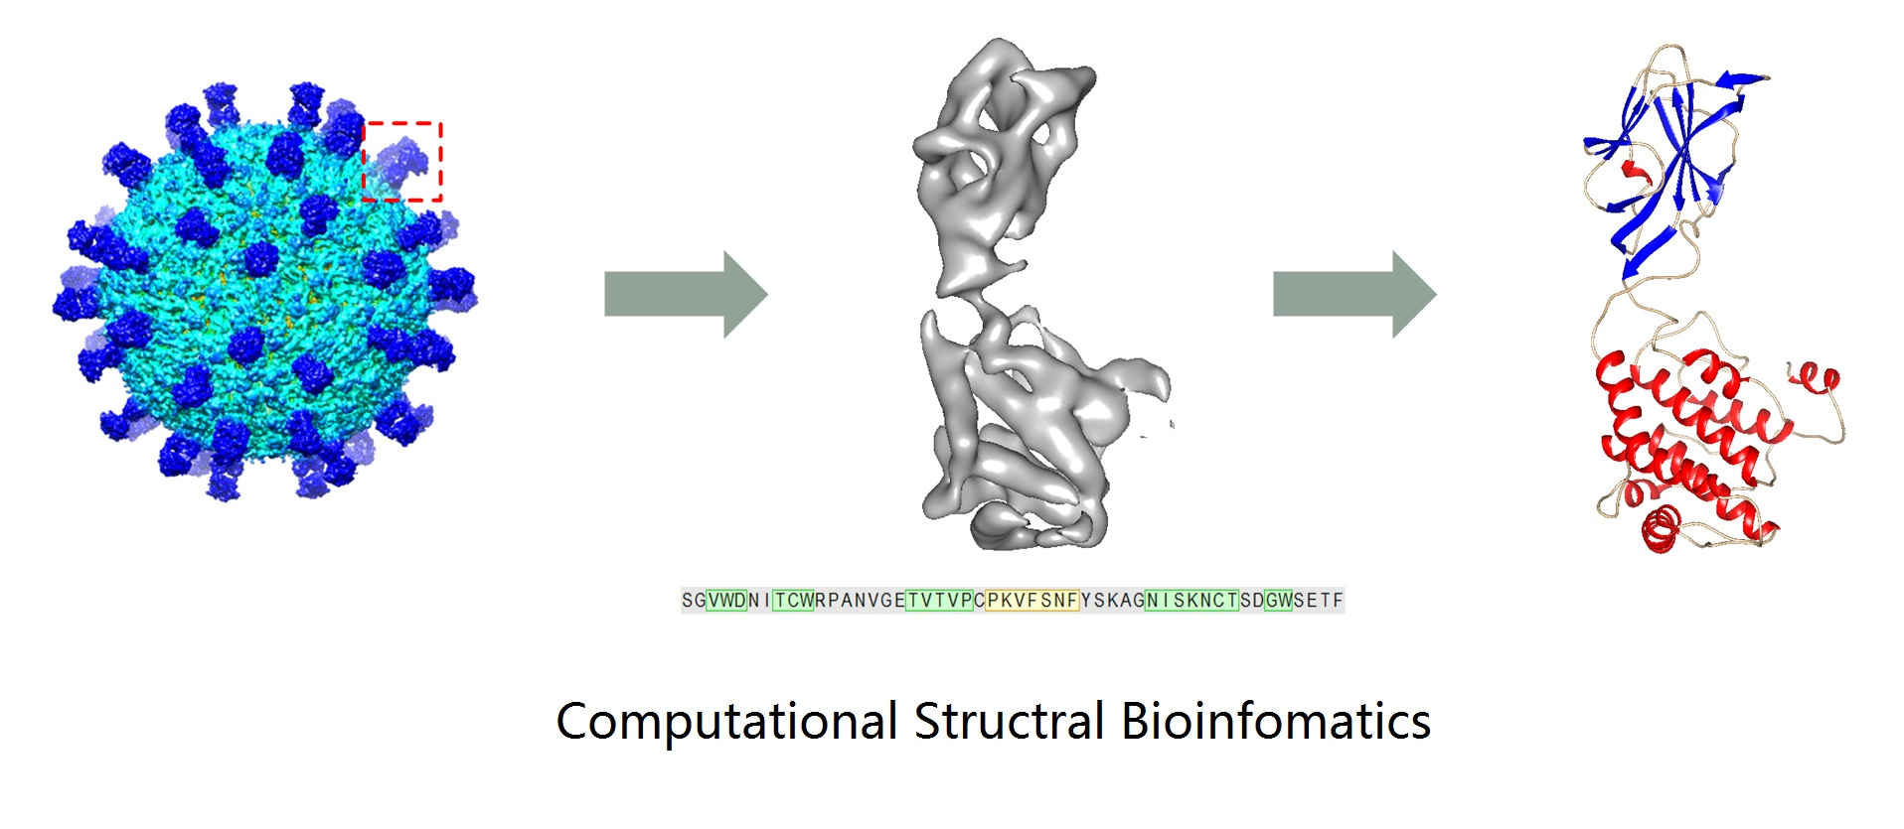
Computational Biology: Overview
Dr. Dong Si
(UW Bothell)

Slide 11
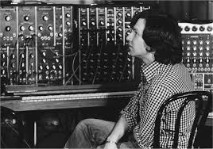
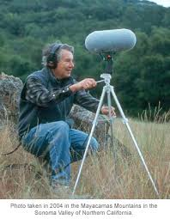
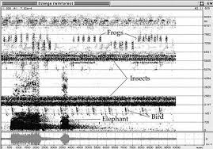
Computational Biology: Overview
Bernie Krause
Early pioneer of synthesizer;
Now studying ecosystems with
Soundscapes; Bioacoustics

Slide 12
Computational Biology: Overview
Bernie Krause
Early pioneer of synthesizer;
Now studying ecosystems with
Soundscapes; Bioacoustics

Slide 13
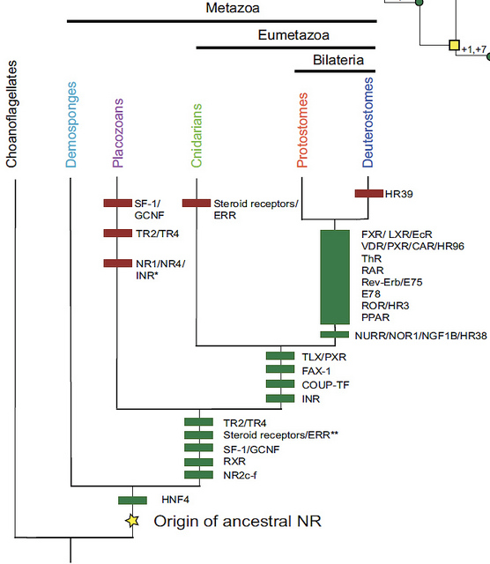
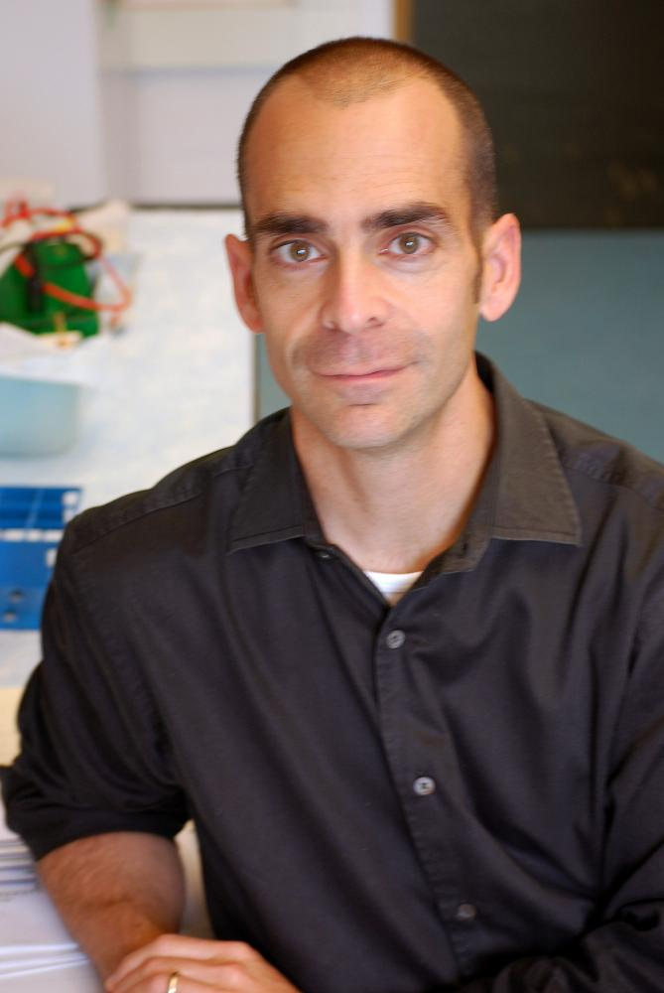
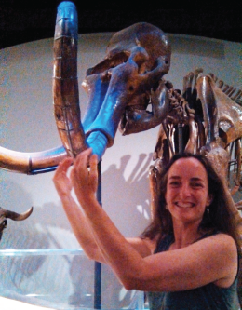
My Background
My background
Undergraduate with Dr. Joe Thornton
and Dr. Jamie Bridgham the University
of Oregon
Gene duplication history implied by the reconciled tree in panel A (not shown). Green bars, duplications; red bars, losses. Duplications are labeled with the named NR lineages they generated. The NR1/NR4/INR ortholog lost in the placozoans (marked *) was generated in the duplication marked **. The large bar comprises numerous duplications that cannot be temporally ordered.
DOI: 10.1371/journal.pbio.1000497

Slide 14
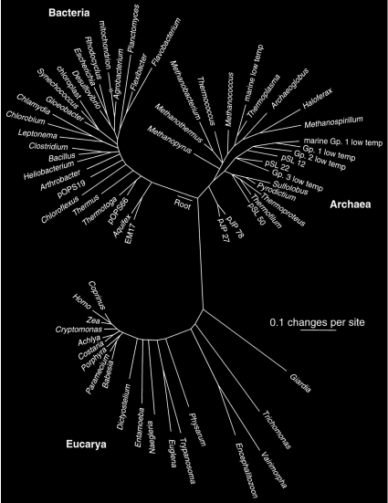
(Pace, 1997)

Slide 15
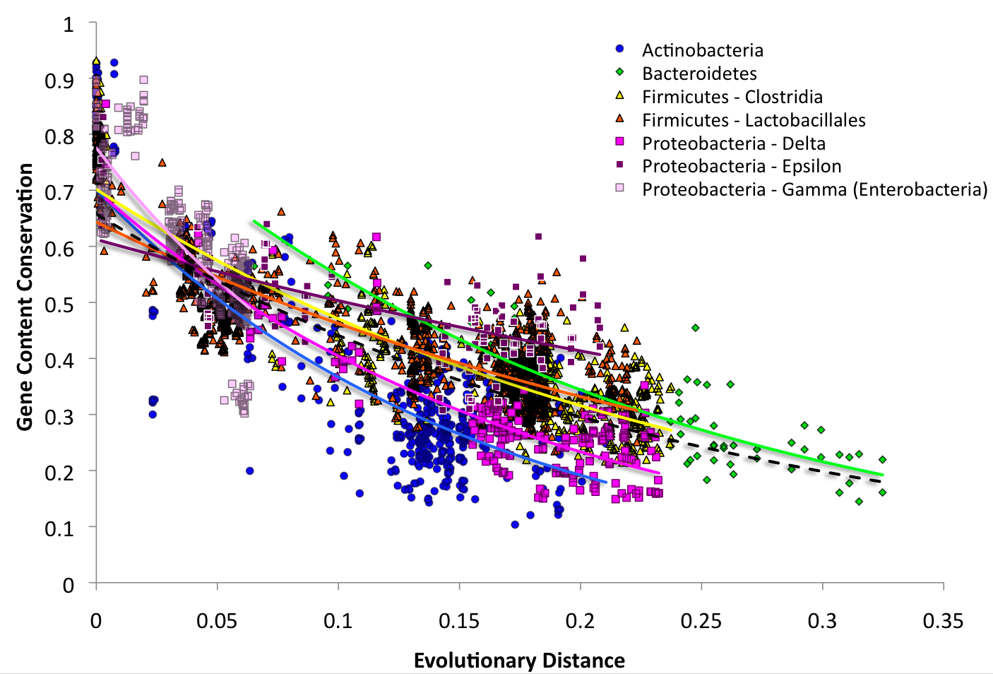
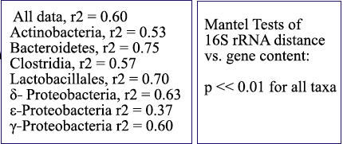
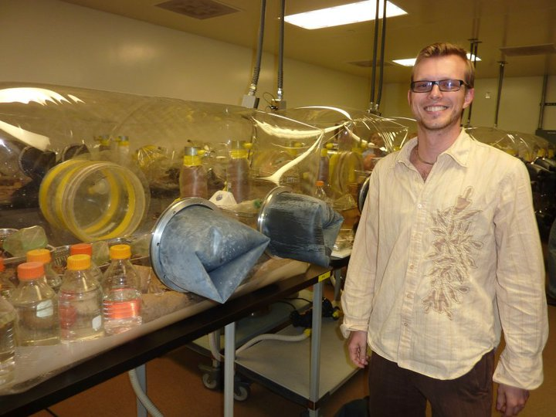
My Background
My background
Ph.D with Dr. Rob Knight
(Gordon Lab Gnotobiotic Mouse Facility)
(Zaneveld et al., NAR, 2010)

Slide 16
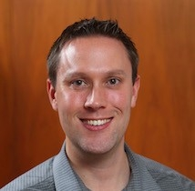
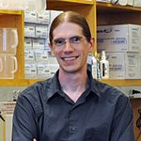
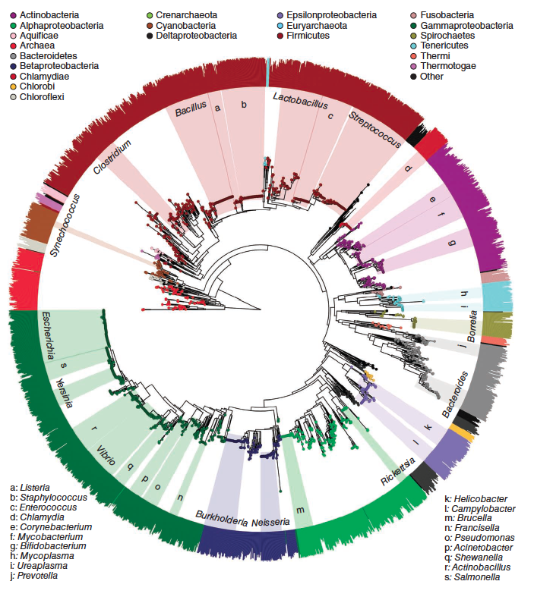
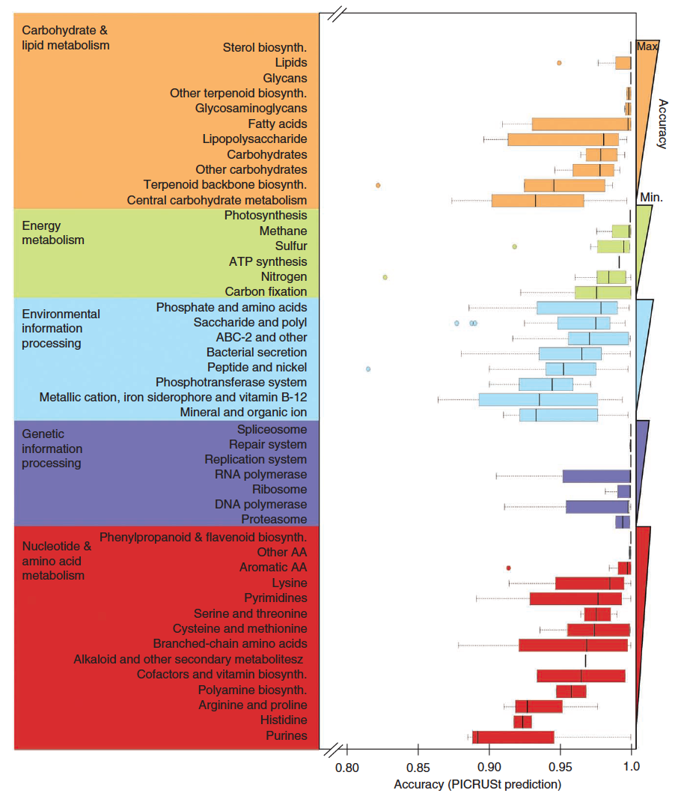
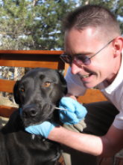
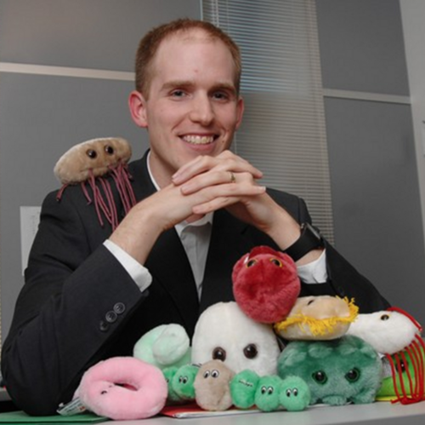
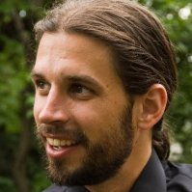
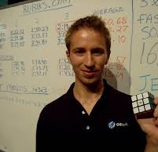
My Background
PICRUSt - phylogenetic predictions of genome contents
(Zaneveld et al., NAR, 2010)
(Langille, Zaneveld et al Nature
Biotech, 2016)

Slide 17

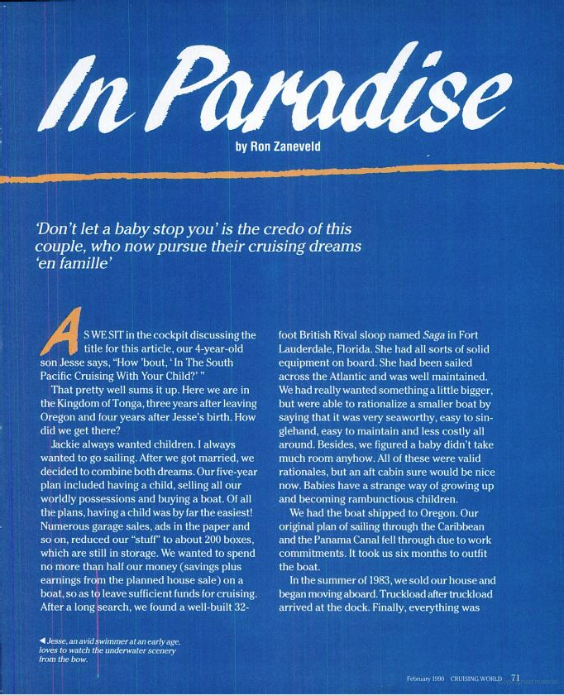
My Background

Slide 18
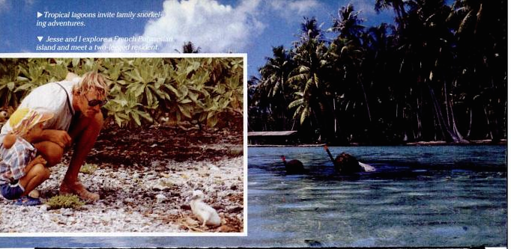
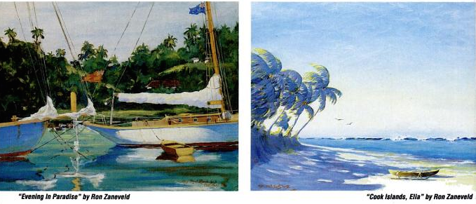
My Background

Slide 19
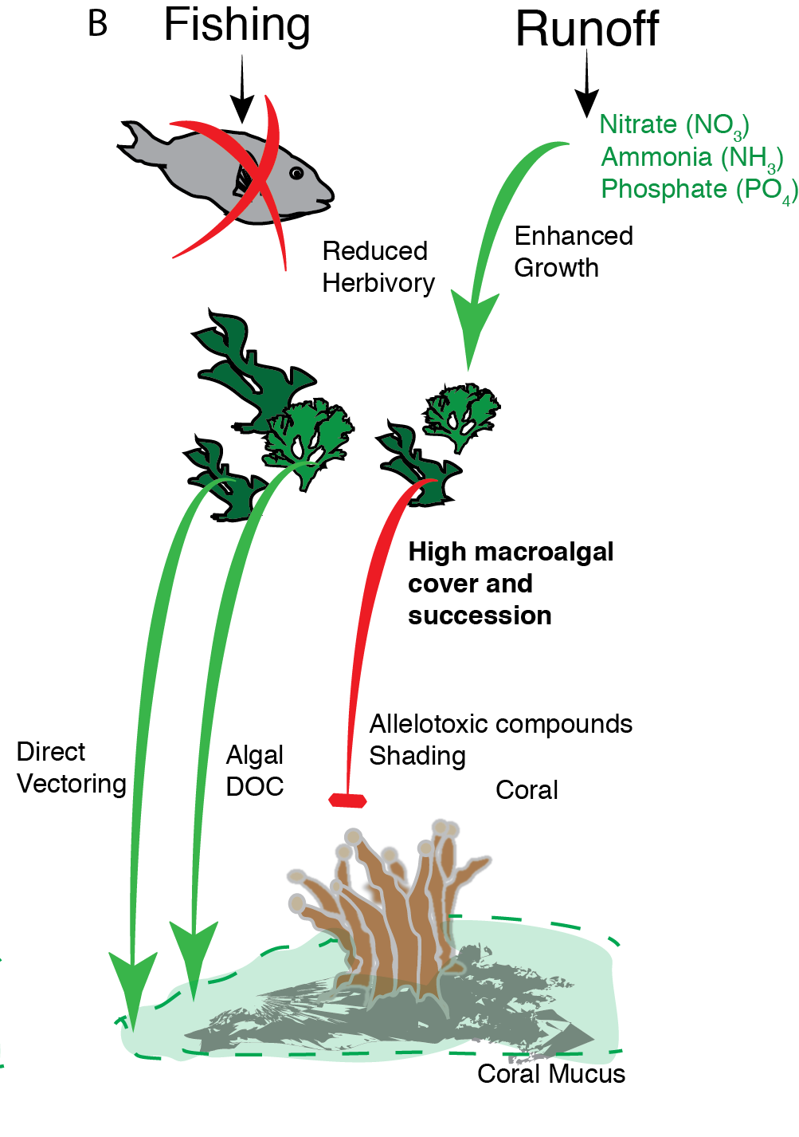
Environmental Impacts
Benthic Community Structure
Microbial Community
Coral Tissue Loss,
Disease and Mortality
(Zaneveld et al., in prep)
(Zaneveld et al, Nature Comm., 2016)

Slide 20
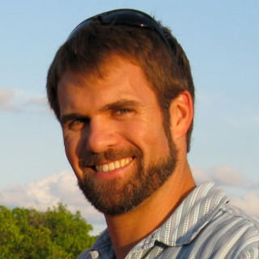
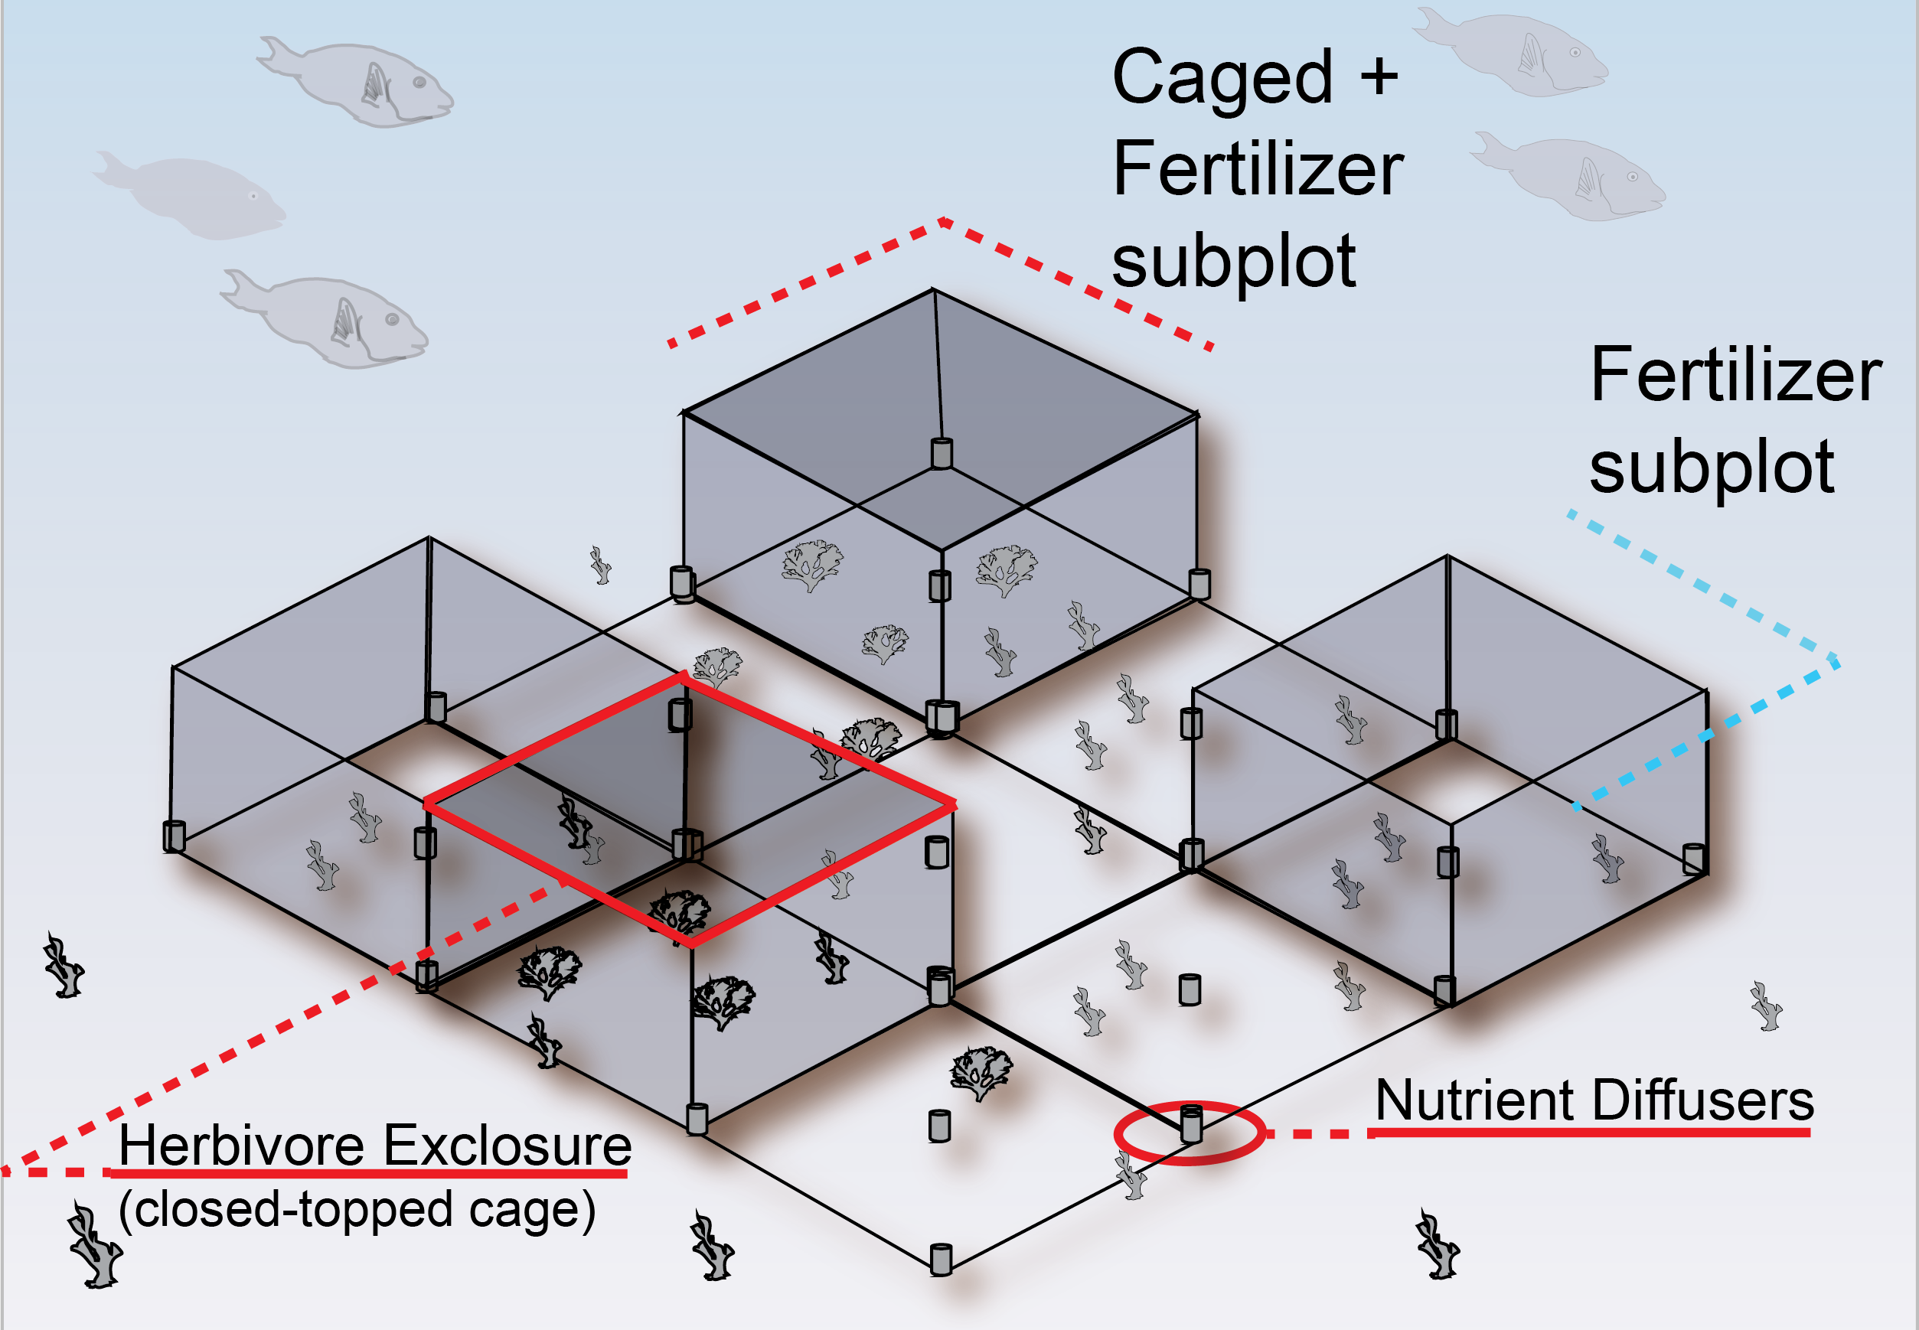
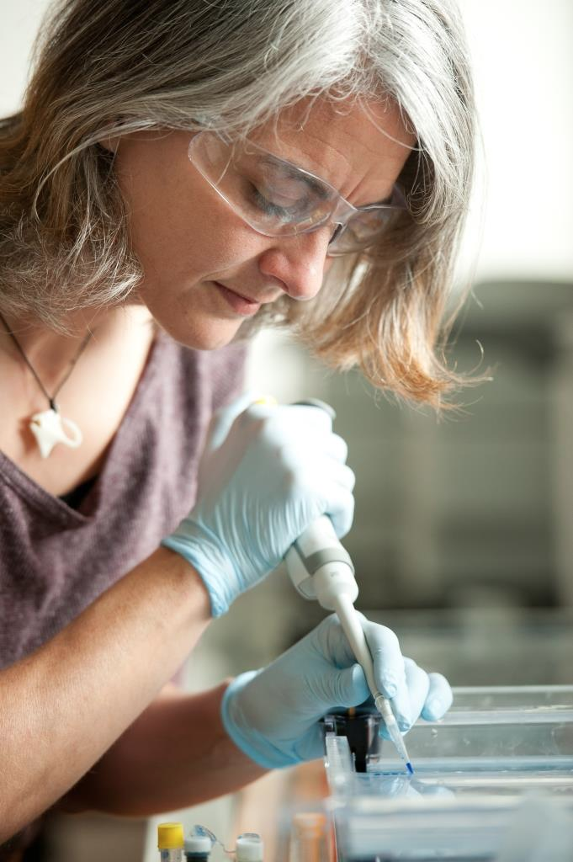
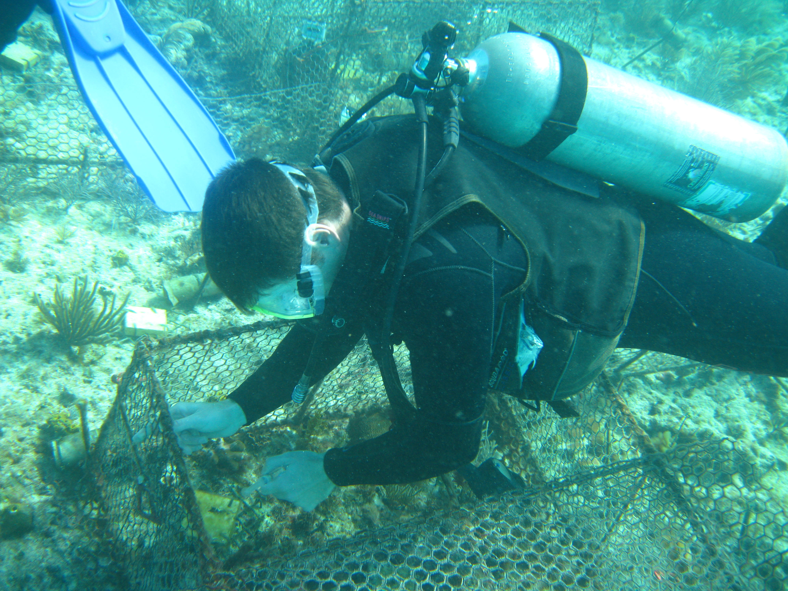
My Background
Project HERBVRE
(Zaneveld, Cruising World, 1990)
(Zaneveld et al, Nature Comm., 2016)

Slide 21
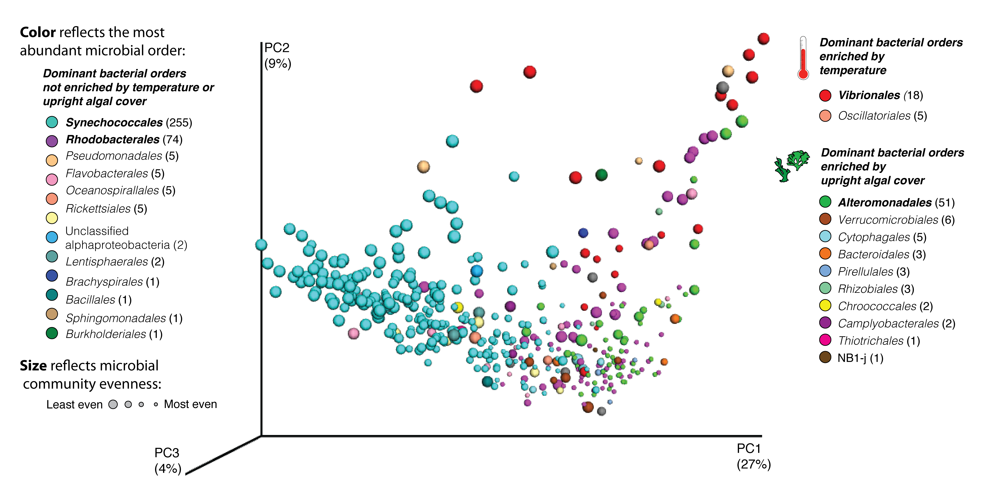
My Background
Project HERBVRE
(Zaneveld, Cruising World, 1990)
(Zaneveld et al, Nature Comm., 2016)

Slide 22
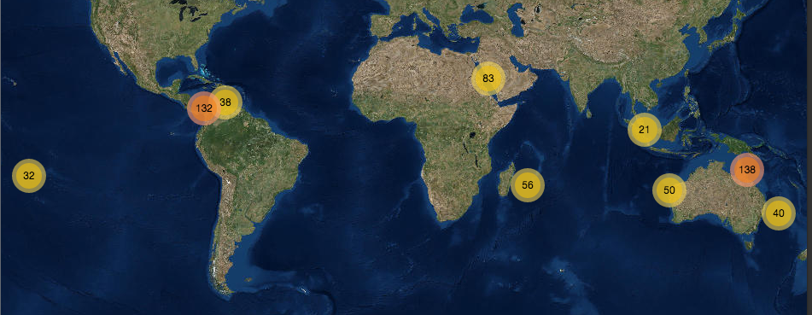
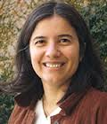
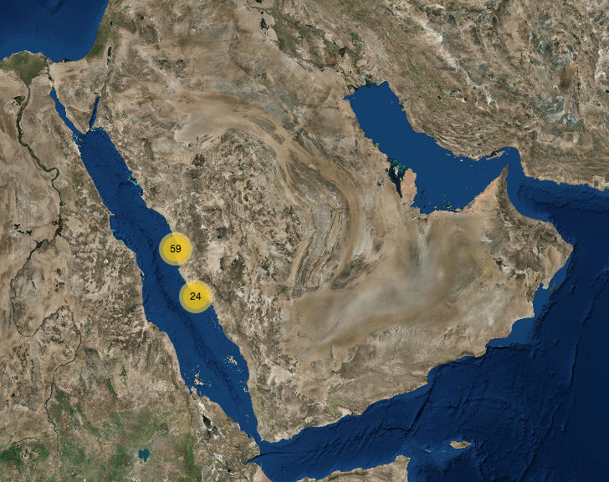
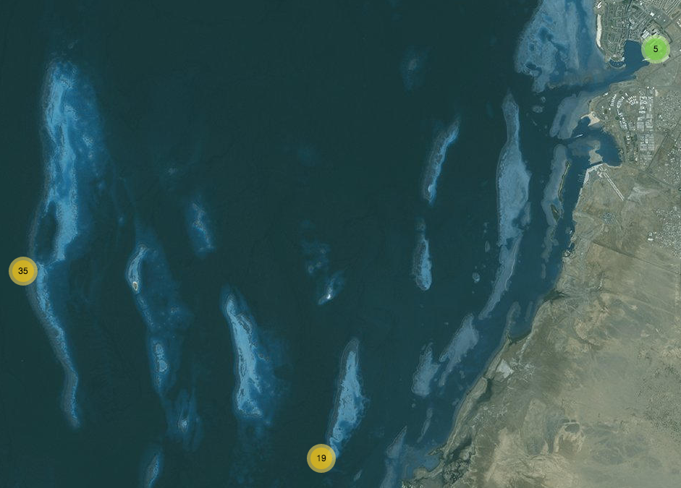
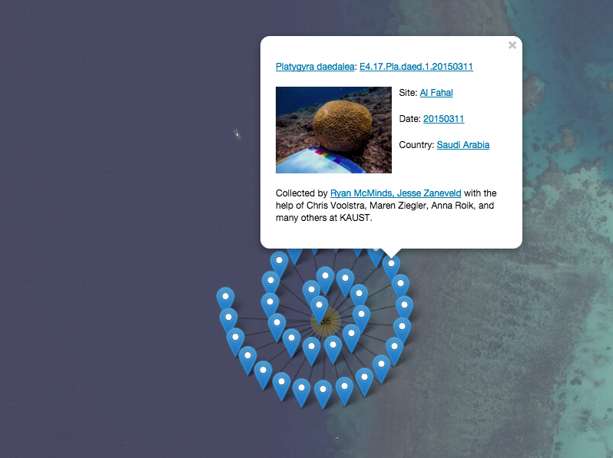
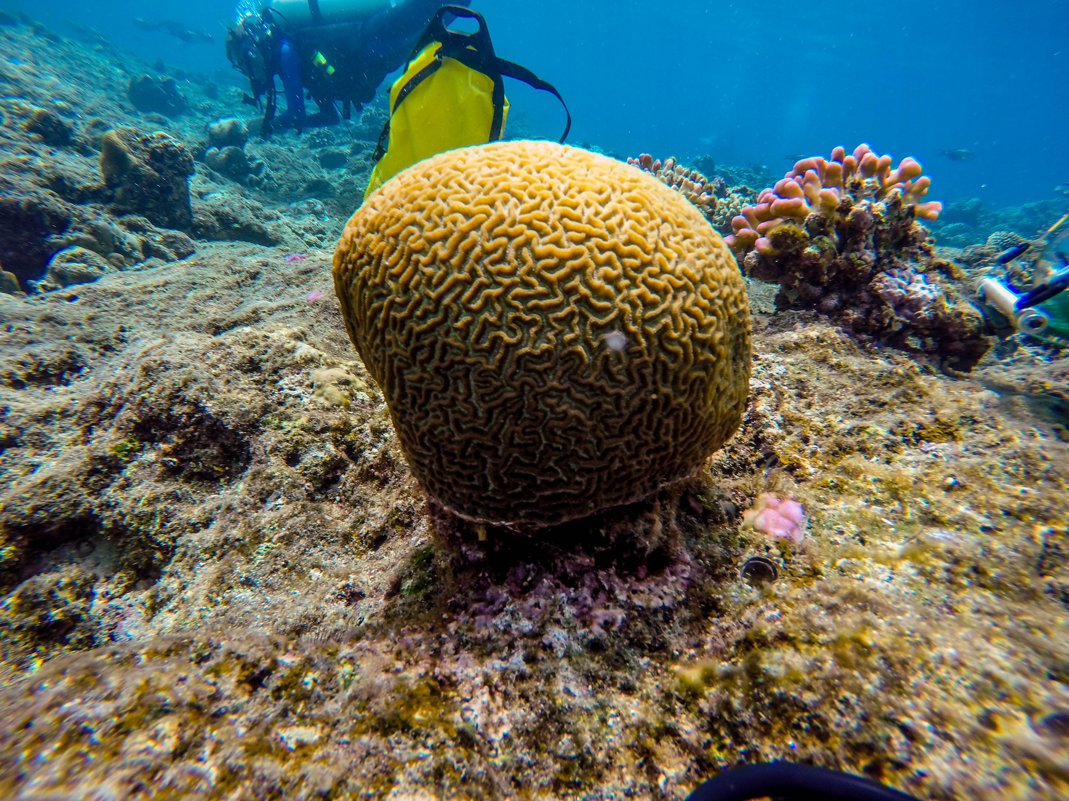
My Background
Global Coral Microbiome Project
Dr. Mónica Medina
(Penn State)
(Zaneveld, Cruising World, 1990)
(Zaneveld et al, Nature Comm., 2016)

Slide 23
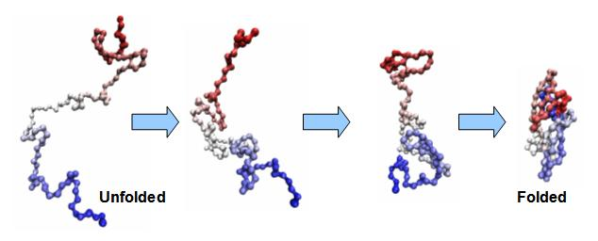
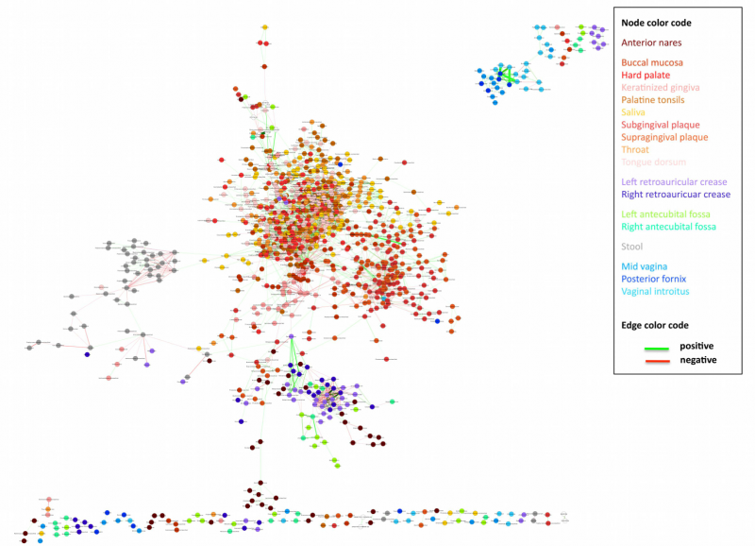
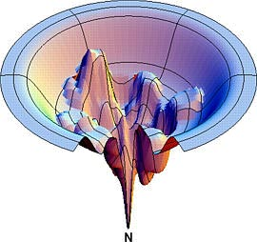
Computational Biology: Overview
Comp Bio encompasses everything from protein folding predictions
to network analysis of biological communities
Source: inst.eecs.berkeley.edu/~ee127a/book/login/exa_protein_folding.html
Source: biomedicalcomputationreview.org/content/microbiome-dealing-data-deluge

Slide 24
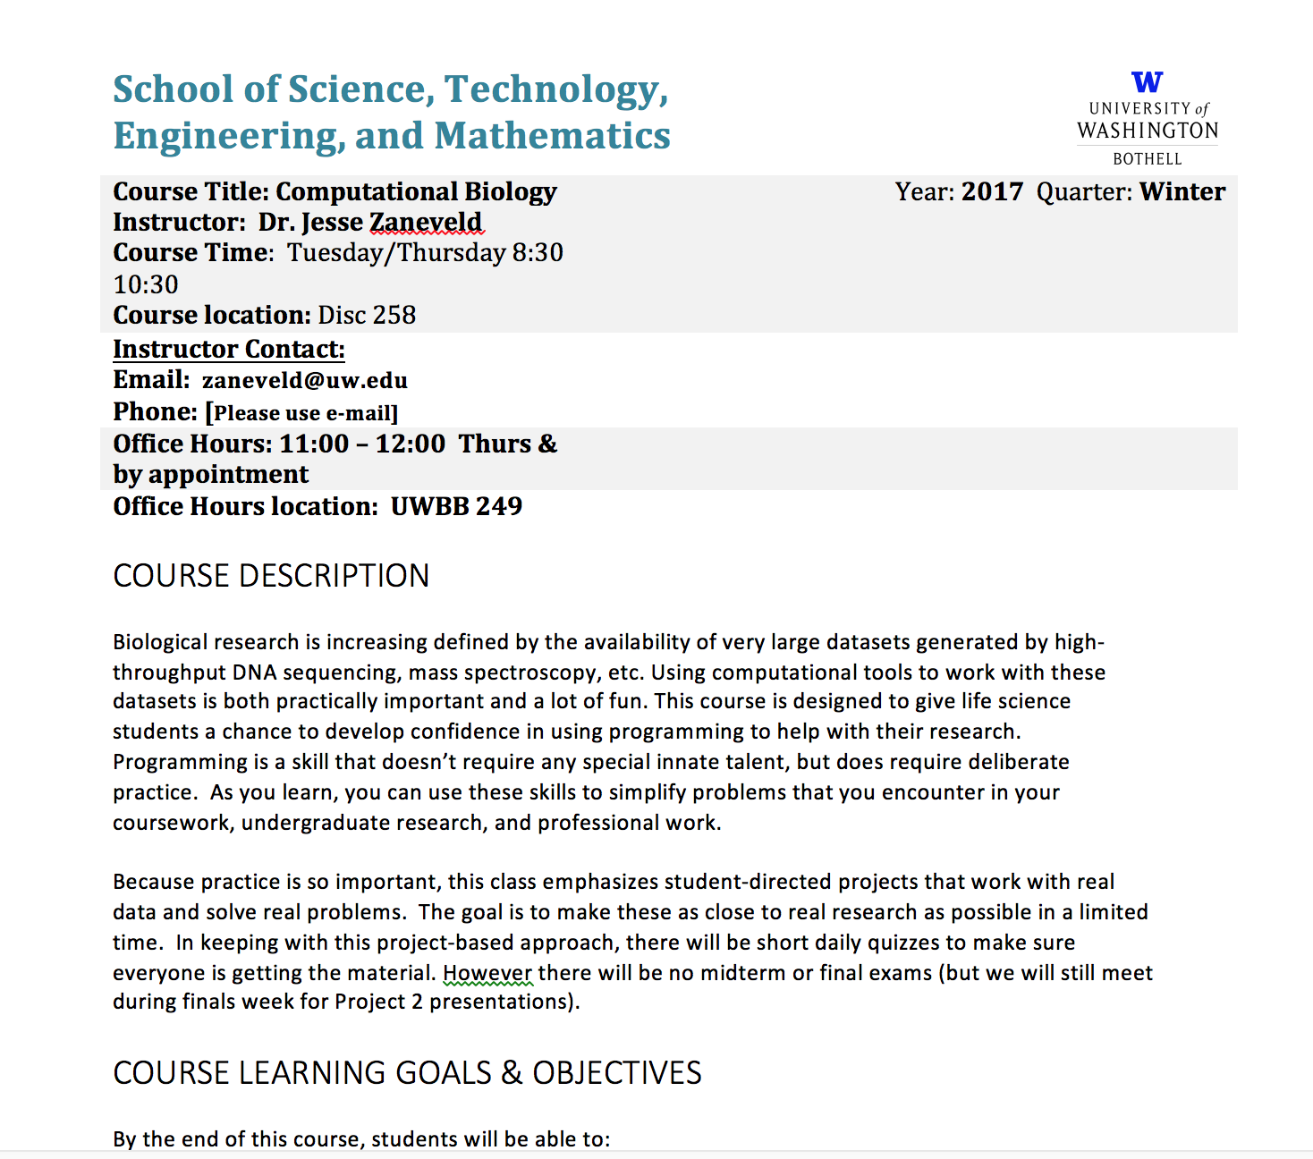
Computational Biology: Syllabus
Source: https://inst.eecs.berkeley.edu/~ee127a/book/login/exa_protein_folding.html

Slide 25

Computational Biology: Central Dogma
Source: https://en.wikipedia.org/wiki/Central_dogma_of_molecular_biology

Slide 26
Computational Biology: Central Dogma
[White board]
Source: https://en.wikipedia.org/wiki/Central_dogma_of_molecular_biology

Slide 27
Computational Biology: Sequences!
Each group gets one set of sequences. The top block of 10 sequences is
Random DNA with equal base frequencies.
Figure out as much as you can about what is going on in the second block
of sequences.
Source: https://inst.eecs.berkeley.edu/~ee127a/book/login/exa_protein_folding.html

Slide 28
Computational Biology: Sequences!
Set 1
seq_1 TTCGAGAGCTCTCTCTCAAATAGCCCCTCCAAGTTATGTGCCTGGATGACCAGCTCATTACCCAGTCTGTTAACACGTCG
seq_2 TCCGTAGCCAACTCTTCTGTGTAACCACCATGCCACCCTGGGGAGCAACTGACTTCCTTCAGTGAACGTCTCTGGAGACT
seq_3 ACATCCTTGGTAGCCAATTCACTGTTCTATAAGTTCTTCGATTAAGTAACTCTTTTTCATCTGGTAAGCTTGGAAGTTTA
seq_4 TGCGCAAGTTGCTTTGAAAGTTCACTTACGGGGGCGAACATAATGCGTTAAACGTGCTCACTAGTTACCAGATGGTTGTA
seq_5 CCCCCGCTTCGGGTAAGTCTAGTAACCACCGAGCAGTGCTGGCGGAGTATCCCGAGGCACAATAGGGCTACACTACCTCT
seq_6 CTGGGACACGTTGCGCCGCGGCTACAGGTCCCTCGCACCGGACTCTTCCTCTCTGTACGGTTGCTTCAATTCATGGGCAT
seq_7 GCGGTCTACCCCCCTACTGATGTCATCGATAGTCCGTGCCCGTTCAGGAGAACTGTGTTCGACTCTTGAGCGGTCACTTC
seq_8 GCCGATGTCGACATCTTCTTCCACCGATAGCCGCTGGCTCAATCTTCACGTACGACCTTTCTTTCTAACTTGCTACCTCC
seq_9 CAGCAAGAATAATGTCTGCGGACTTGCGTGATTCTCTGTACTAACTGGTGTCATTCTACCATAGCAGACTAGATTGAGTT
seq_10 GGAAAAAATGCGGTATATGACATCAGTTCAGATAGAACGATTCAATAGCAGGACTGGTCCTGCACTGCCAACACTGAGCG
seq_11 CGGCGCGGTCGGCCTGCGAGTGCCGGCGGCCCGGCGGAGCCCCCCCGCGACAGGCGCCCGGGCCCGCGCCCGCGCCTGGC
seq_12 CCGCCCGGGGGGGGACCGGCGGGCCGGGTGGTCGGCGCGGCCGCGGGCGGACTGGTCGGGGCCGGAGGCCAGCGGAGGGG
seq_13 GCAGCGGCCCGGCGGCACCTTGTCGCGACGCGCCGCTGCGCCCCCCGCGGCCCCCGCCCCGCCGGGCAGCTGGGCGGCCA
seq_14 GCCGGTCCCGCGGCCGCTGGCCCTTGCCGATCGCCTCGCCCGGGCCCAGCGCCGCCCCGGCCGTCAGCGGCGGCTCAACC
seq_15 GACCCCCCGCCCCCCCCGGGCGCTACGGGGCTGGCCACCCCGGGGCCCCGCGCGGGCAACCCGGGCCGCGGGAGCTTCGG
seq_16 CGTCCGCCAGACCCCGGTGCGCCAGCGCAGCGCGAGGCGTGGGGGGGCCCGGCCCCGGGCCCCGCTCGGCGGCCCCACCG
seq_17 CAACCGGGCCCCAAGAGCGGGCGCGGAGCGGGGGGCCGCGCGCTGCCCGGGCCGGATCGCCGCGGGCCCCCGCCCCCCGC
seq_18 GGCGCTGACCCCGGCCCCGCGGCGCCGTGGACGGCCCGGGGAGCCCGCCCGCATCGCGTTTGCCGGGCGCCCGCCGGGCG
seq_19 CCCCGGGCGCCGGGCCGTGCAGGCCCGGACCCCCCGCGCGGCCCCCCCGCCCCCGGCCCCCCCCACGGCAGGGGTGCTGG
seq_20 GGGGACCCGCCCGGGTGTCGCCCCCAGCCCCCCCGGCCCGCGCGCCCCGGGGGCCCCGGCCGCGCCGGACCCGGCGGGGG
Source: https://inst.eecs.berkeley.edu/~ee127a/book/login/exa_protein_folding.html

Slide 29
Computational Biology: Sequences!
Set 1
seq_1 TTCGAGAGCTCTCTCTCAAATAGCCCCTCCAAGTTATGTGCCTGGATGACCAGCTCATTACCCAGTCTGTTAACACGTCG
seq_2 TCCGTAGCCAACTCTTCTGTGTAACCACCATGCCACCCTGGGGAGCAACTGACTTCCTTCAGTGAACGTCTCTGGAGACT
seq_3 ACATCCTTGGTAGCCAATTCACTGTTCTATAAGTTCTTCGATTAAGTAACTCTTTTTCATCTGGTAAGCTTGGAAGTTTA
seq_4 TGCGCAAGTTGCTTTGAAAGTTCACTTACGGGGGCGAACATAATGCGTTAAACGTGCTCACTAGTTACCAGATGGTTGTA
seq_5 CCCCCGCTTCGGGTAAGTCTAGTAACCACCGAGCAGTGCTGGCGGAGTATCCCGAGGCACAATAGGGCTACACTACCTCT
seq_6 CTGGGACACGTTGCGCCGCGGCTACAGGTCCCTCGCACCGGACTCTTCCTCTCTGTACGGTTGCTTCAATTCATGGGCAT
seq_7 GCGGTCTACCCCCCTACTGATGTCATCGATAGTCCGTGCCCGTTCAGGAGAACTGTGTTCGACTCTTGAGCGGTCACTTC
seq_8 GCCGATGTCGACATCTTCTTCCACCGATAGCCGCTGGCTCAATCTTCACGTACGACCTTTCTTTCTAACTTGCTACCTCC
seq_9 CAGCAAGAATAATGTCTGCGGACTTGCGTGATTCTCTGTACTAACTGGTGTCATTCTACCATAGCAGACTAGATTGAGTT
seq_10 GGAAAAAATGCGGTATATGACATCAGTTCAGATAGAACGATTCAATAGCAGGACTGGTCCTGCACTGCCAACACTGAGCG
seq_11 CGGCGCGGTCGGCCTGCGAGTGCCGGCGGCCCGGCGGAGCCCCCCCGCGACAGGCGCCCGGGCCCGCGCCCGCGCCTGGC
seq_12 CCGCCCGGGGGGGGACCGGCGGGCCGGGTGGTCGGCGCGGCCGCGGGCGGACTGGTCGGGGCCGGAGGCCAGCGGAGGGG
seq_13 GCAGCGGCCCGGCGGCACCTTGTCGCGACGCGCCGCTGCGCCCCCCGCGGCCCCCGCCCCGCCGGGCAGCTGGGCGGCCA
seq_14 GCCGGTCCCGCGGCCGCTGGCCCTTGCCGATCGCCTCGCCCGGGCCCAGCGCCGCCCCGGCCGTCAGCGGCGGCTCAACC
seq_15 GACCCCCCGCCCCCCCCGGGCGCTACGGGGCTGGCCACCCCGGGGCCCCGCGCGGGCAACCCGGGCCGCGGGAGCTTCGG
seq_16 CGTCCGCCAGACCCCGGTGCGCCAGCGCAGCGCGAGGCGTGGGGGGGCCCGGCCCCGGGCCCCGCTCGGCGGCCCCACCG
seq_17 CAACCGGGCCCCAAGAGCGGGCGCGGAGCGGGGGGCCGCGCGCTGCCCGGGCCGGATCGCCGCGGGCCCCCGCCCCCCGC
seq_18 GGCGCTGACCCCGGCCCCGCGGCGCCGTGGACGGCCCGGGGAGCCCGCCCGCATCGCGTTTGCCGGGCGCCCGCCGGGCG
seq_19 CCCCGGGCGCCGGGCCGTGCAGGCCCGGACCCCCCGCGCGGCCCCCCCGCCCCCGGCCCCCCCCACGGCAGGGGTGCTGG
seq_20 GGGGACCCGCCCGGGTGTCGCCCCCAGCCCCCCCGGCCCGCGCGCCCCGGGGGCCCCGGCCGCGCCGGACCCGGCGGGGG
The upper set of sequences has equal base content; the lower set of sequences has higher
GC content. Note how unbalanced GC content generates more ‘runs’ of nucleotides.
Source: https://inst.eecs.berkeley.edu/~ee127a/book/login/exa_protein_folding.html

Slide 30

Computational Biology: Sequences!
GC base pairs more stable, which can be important in e.g. RNA structure of rRNA and tRNA
at high temperatures
Source: https://en.wikipedia.org/wiki/GC-content

Slide 31
Computational Biology: Sequences!
Set 2
seq_1 TTCGAGAGCTCTCTCTCAAATAGCCCCTCCAAGTTATGTGCCTGGATGACCAGCTCATTACCCAGTCTGTTAACACGTCG
seq_2 TCCGTAGCCAACTCTTCTGTGTAACCACCATGCCACCCTGGGGAGCAACTGACTTCCTTCAGTGAACGTCTCTGGAGACT
seq_3 ACATCCTTGGTAGCCAATTCACTGTTCTATAAGTTCTTCGATTAAGTAACTCTTTTTCATCTGGTAAGCTTGGAAGTTTA
seq_4 TGCGCAAGTTGCTTTGAAAGTTCACTTACGGGGGCGAACATAATGCGTTAAACGTGCTCACTAGTTACCAGATGGTTGTA
seq_5 CCCCCGCTTCGGGTAAGTCTAGTAACCACCGAGCAGTGCTGGCGGAGTATCCCGAGGCACAATAGGGCTACACTACCTCT
seq_6 CTGGGACACGTTGCGCCGCGGCTACAGGTCCCTCGCACCGGACTCTTCCTCTCTGTACGGTTGCTTCAATTCATGGGCAT
seq_7 GCGGTCTACCCCCCTACTGATGTCATCGATAGTCCGTGCCCGTTCAGGAGAACTGTGTTCGACTCTTGAGCGGTCACTTC
seq_8 GCCGATGTCGACATCTTCTTCCACCGATAGCCGCTGGCTCAATCTTCACGTACGACCTTTCTTTCTAACTTGCTACCTCC
seq_9 CAGCAAGAATAATGTCTGCGGACTTGCGTGATTCTCTGTACTAACTGGTGTCATTCTACCATAGCAGACTAGATTGAGTT
seq_10 GGAAAAAATGCGGTATATGACATCAGTTCAGATAGAACGATTCAATAGCAGGACTGGTCCTGCACTGCCAACACTGAGCG
seq_21 CCCCGCCGCGTTGACACGGTCGGGCCGGGCCGCTATAATCCACCCCGCACGCCGGCCCCTAGGGTGCCGATGGATGAGGG
seq_22 CCCGGGCCAGTTGACACCCCTGCCGGCGCGGCCTATAATGCCCCCGCAACGGGGCCGCCGGCGGCCCGGGGGTCAGCGCG
seq_23 AGCGGCCGCCTTGACAGCGGCGGTTGCGCGCCCTATAATGGCGCCAGGACGGCGCGCGCGCAGCCGGCGGGGCGCGCGGC
seq_24 GGCCCTCCGGTTGACAGCGCAGCCCCCGCGGCCTATAATTGCCGGGGCACCCGGCCGGGCCGCGGACCCGCGCCCTGGGG
seq_25 GGAGGCTTACTTGACAGGCGGACGCCCGCCCCATATAATGGGCAATGTACGGGGGGGCGGGAAGCCGCGGGCGGCCCGGG
seq_26 GCGGGTCGGGTTGACAGCGCCCGCACCCCCGGCTATAATCGACACGGGACTGCGCCCAGCCGGGCCGACCGCCCGACGAC
seq_27 CGCGGCCGCGTTGACACTCCGCGCCGGCGGCGGTATAATCGAGCGGTCAGCTGGGCGCGCCTGAGCGCCCGCCTCGCGGA
seq_28 CGCTTGGGGATTGACACCGCGCGGCACGTCGCGTATAATGCCGGGGGAACAGCCCCTCCGCCCCACGCGGCCGGCGGCGG
seq_29 GCGGCGCGGGTTGACAGCGCGCCGGCGTGGTGCTATAATGCCGGGGCCACCGAAGGGCGCGCGGCCCCGGCCGCCGCCGT
seq_30 CGGCCCCGCGTTGACAGGCCCGCGGGCCACGGCTATAATGCGGGCGCCACTGCCCCCGTCGCGGCCGCGGGCGCCGCGGC
Source: https://inst.eecs.berkeley.edu/~ee127a/book/login/exa_protein_folding.html

Slide 32
Computational Biology: Sequences!
Set 2
seq_1 TTCGAGAGCTCTCTCTCAAATAGCCCCTCCAAGTTATGTGCCTGGATGACCAGCTCATTACCCAGTCTGTTAACACGTCG
seq_2 TCCGTAGCCAACTCTTCTGTGTAACCACCATGCCACCCTGGGGAGCAACTGACTTCCTTCAGTGAACGTCTCTGGAGACT
seq_3 ACATCCTTGGTAGCCAATTCACTGTTCTATAAGTTCTTCGATTAAGTAACTCTTTTTCATCTGGTAAGCTTGGAAGTTTA
seq_4 TGCGCAAGTTGCTTTGAAAGTTCACTTACGGGGGCGAACATAATGCGTTAAACGTGCTCACTAGTTACCAGATGGTTGTA
seq_5 CCCCCGCTTCGGGTAAGTCTAGTAACCACCGAGCAGTGCTGGCGGAGTATCCCGAGGCACAATAGGGCTACACTACCTCT
seq_6 CTGGGACACGTTGCGCCGCGGCTACAGGTCCCTCGCACCGGACTCTTCCTCTCTGTACGGTTGCTTCAATTCATGGGCAT
seq_7 GCGGTCTACCCCCCTACTGATGTCATCGATAGTCCGTGCCCGTTCAGGAGAACTGTGTTCGACTCTTGAGCGGTCACTTC
seq_8 GCCGATGTCGACATCTTCTTCCACCGATAGCCGCTGGCTCAATCTTCACGTACGACCTTTCTTTCTAACTTGCTACCTCC
seq_9 CAGCAAGAATAATGTCTGCGGACTTGCGTGATTCTCTGTACTAACTGGTGTCATTCTACCATAGCAGACTAGATTGAGTT
seq_10 GGAAAAAATGCGGTATATGACATCAGTTCAGATAGAACGATTCAATAGCAGGACTGGTCCTGCACTGCCAACACTGAGCG
seq_21 CCCCGCCGCGTTGACACGGTCGGGCCGGGCCGCTATAATCCACCCCGCACGCCGGCCCCTAGGGTGCCGATGGATGAGGG
seq_22 CCCGGGCCAGTTGACACCCCTGCCGGCGCGGCCTATAATGCCCCCGCAACGGGGCCGCCGGCGGCCCGGGGGTCAGCGCG
seq_23 AGCGGCCGCCTTGACAGCGGCGGTTGCGCGCCCTATAATGGCGCCAGGACGGCGCGCGCGCAGCCGGCGGGGCGCGCGGC
seq_24 GGCCCTCCGGTTGACAGCGCAGCCCCCGCGGCCTATAATTGCCGGGGCACCCGGCCGGGCCGCGGACCCGCGCCCTGGGG
seq_25 GGAGGCTTACTTGACAGGCGGACGCCCGCCCCATATAATGGGCAATGTACGGGGGGGCGGGAAGCCGCGGGCGGCCCGGG
seq_26 GCGGGTCGGGTTGACAGCGCCCGCACCCCCGGCTATAATCGACACGGGACTGCGCCCAGCCGGGCCGACCGCCCGACGAC
seq_27 CGCGGCCGCGTTGACACTCCGCGCCGGCGGCGGTATAATCGAGCGGTCAGCTGGGCGCGCCTGAGCGCCCGCCTCGCGGA
seq_28 CGCTTGGGGATTGACACCGCGCGGCACGTCGCGTATAATGCCGGGGGAACAGCCCCTCCGCCCCACGCGGCCGGCGGCGG
seq_29 GCGGCGCGGGTTGACAGCGCGCCGGCGTGGTGCTATAATGCCGGGGCCACCGAAGGGCGCGCGGCCCCGGCCGCCGCCGT
seq_30 CGGCCCCGCGTTGACAGGCCCGCGGGCCACGGCTATAATGCGGGCGCCACTGCCCCCGTCGCGGCCGCGGGCGCCGCGGC
Source: https://inst.eecs.berkeley.edu/~ee127a/book/login/exa_protein_folding.html

Slide 33

Computational Biology: Sequences!
Set 2 – an idealized TATA box (here as an E.coli promoter)
Source: https://www.mun.ca/biology/scarr/MGA2-03-11.jpg

Slide 34
Computational Biology: Sequences!
Set 3 – Altered dinucleotide usage
seq_1 TTCGAGAGCTCTCTCTCAAATAGCCCCTCCAAGTTATGTGCCTGGATGACCAGCTCATTACCCAGTCTGTTAACACGTCG
seq_2 TCCGTAGCCAACTCTTCTGTGTAACCACCATGCCACCCTGGGGAGCAACTGACTTCCTTCAGTGAACGTCTCTGGAGACT
seq_3 ACATCCTTGGTAGCCAATTCACTGTTCTATAAGTTCTTCGATTAAGTAACTCTTTTTCATCTGGTAAGCTTGGAAGTTTA
seq_4 TGCGCAAGTTGCTTTGAAAGTTCACTTACGGGGGCGAACATAATGCGTTAAACGTGCTCACTAGTTACCAGATGGTTGTA
seq_5 CCCCCGCTTCGGGTAAGTCTAGTAACCACCGAGCAGTGCTGGCGGAGTATCCCGAGGCACAATAGGGCTACACTACCTCT
seq_6 CTGGGACACGTTGCGCCGCGGCTACAGGTCCCTCGCACCGGACTCTTCCTCTCTGTACGGTTGCTTCAATTCATGGGCAT
seq_7 GCGGTCTACCCCCCTACTGATGTCATCGATAGTCCGTGCCCGTTCAGGAGAACTGTGTTCGACTCTTGAGCGGTCACTTC
seq_8 GCCGATGTCGACATCTTCTTCCACCGATAGCCGCTGGCTCAATCTTCACGTACGACCTTTCTTTCTAACTTGCTACCTCC
seq_9 CAGCAAGAATAATGTCTGCGGACTTGCGTGATTCTCTGTACTAACTGGTGTCATTCTACCATAGCAGACTAGATTGAGTT
seq_10 GGAAAAAATGCGGTATATGACATCAGTTCAGATAGAACGATTCAATAGCAGGACTGGTCCTGCACTGCCAACACTGAGCG
seq_31 GCATCTATGCACACTGTCGAATACTGATAGTAACACAGCATACACTAGCAAGGAAGTGAGTGCTCTAGAGTGTCGACTAC
seq_32 GCTGCGCAACGATGTGCGTGTGTCACGATGTGGATGCTTCCACTTGTGCGTGCTTGTGAGATTGCGGCTAACGCGAAGTG
seq_33 CGTGTATCATGACTAGTCACAGCGTGAGTGCGTGCGTGATTGTCTGTGTGCTCTCGTGTGTGCGACACCACTGCGAGCAC
seq_34 TCTCTGGATCCTTGTGGCGACGCATGTGGCAGTGTATGTGCATGGCGATCAGTGCATGCACTTGCGCATGTGTGTGTATC
seq_35 GACGACATCTTGTGACTGTGCATGATCGTGTGTGAGTCACTGATCTAGTGACCGGAGCGCGATGTGTGCACATGTGACTC
seq_36 TGCAACTACGTGACATTAGCTGTGTGACCTTGTGTCGATGTGTGGCCTTGTATATATGTGATTGGAATTGTGTCGCTGTG
seq_37 TGTCCTTGGCTATGACACCATGATCTATAGTATATGTGTGCGTGGACGCTCGTGTGACCGGCCTTCTGTGTGTAACTATG
seq_38 TGACACCACACGCTCGTCTGAGTGTGTGATGCTATGTGAGGAAGCTTGTGTGTAATTGGACAGCTGTCTGCGGATGCTGC
seq_39 AGTGTATCCATGTGCAGATGTGTGATTGTGTACATGAGCTACATACGATGACTGCGTGTGCTTCTGTGAGTGTCCTCGAT
seq_40 TGTCTGCTGCATAGTAAGAGCACATGTGTGATTGTATGAGTGACTGGAGATGGCGCGCTGTGCAATATTGTGCGATCATA
Source: https://inst.eecs.berkeley.edu/~ee127a/book/login/exa_protein_folding.html

Slide 35
Computational Biology: Sequences!
Set 3 – Altered dinucleotide usage
seq_1 TTCGAGAGCTCTCTCTCAAATAGCCCCTCCAAGTTATGTGCCTGGATGACCAGCTCATTACCCAGTCTGTTAACACGTCG
seq_2 TCCGTAGCCAACTCTTCTGTGTAACCACCATGCCACCCTGGGGAGCAACTGACTTCCTTCAGTGAACGTCTCTGGAGACT
seq_3 ACATCCTTGGTAGCCAATTCACTGTTCTATAAGTTCTTCGATTAAGTAACTCTTTTTCATCTGGTAAGCTTGGAAGTTTA
seq_4 TGCGCAAGTTGCTTTGAAAGTTCACTTACGGGGGCGAACATAATGCGTTAAACGTGCTCACTAGTTACCAGATGGTTGTA
seq_5 CCCCCGCTTCGGGTAAGTCTAGTAACCACCGAGCAGTGCTGGCGGAGTATCCCGAGGCACAATAGGGCTACACTACCTCT
seq_6 CTGGGACACGTTGCGCCGCGGCTACAGGTCCCTCGCACCGGACTCTTCCTCTCTGTACGGTTGCTTCAATTCATGGGCAT
seq_7 GCGGTCTACCCCCCTACTGATGTCATCGATAGTCCGTGCCCGTTCAGGAGAACTGTGTTCGACTCTTGAGCGGTCACTTC
seq_8 GCCGATGTCGACATCTTCTTCCACCGATAGCCGCTGGCTCAATCTTCACGTACGACCTTTCTTTCTAACTTGCTACCTCC
seq_9 CAGCAAGAATAATGTCTGCGGACTTGCGTGATTCTCTGTACTAACTGGTGTCATTCTACCATAGCAGACTAGATTGAGTT
seq_10 GGAAAAAATGCGGTATATGACATCAGTTCAGATAGAACGATTCAATAGCAGGACTGGTCCTGCACTGCCAACACTGAGCG
seq_31 GCATCTATGCACACTGTCGAATACTGATAGTAACACAGCATACACTAGCAAGGAAGTGAGTGCTCTAGAGTGTCGACTAC TG=6 AT=5 TT=0 CT=7
seq_32 GCTGCGCAACGATGTGCGTGTGTCACGATGTGGATGCTTCCACTTGTGCGTGCTTGTGAGATTGCGGCTAACGCGAAGTG TG=15 AT=4 TT=4 CT=5
seq_33 CGTGTATCATGACTAGTCACAGCGTGAGTGCGTGCGTGATTGTCTGTGTGCTCTCGTGTGTGCGACACCACTGCGAGCAC TG=15
seq_34 TCTCTGGATCCTTGTGGCGACGCATGTGGCAGTGTATGTGCATGGCGATCAGTGCATGCACTTGCGCATGTGTGTGTATC TG=16
seq_35 GACGACATCTTGTGACTGTGCATGATCGTGTGTGAGTCACTGATCTAGTGACCGGAGCGCGATGTGTGCACATGTGACTC
seq_36 TGCAACTACGTGACATTAGCTGTGTGACCTTGTGTCGATGTGTGGCCTTGTATATATGTGATTGGAATTGTGTCGCTGTG
seq_37 TGTCCTTGGCTATGACACCATGATCTATAGTATATGTGTGCGTGGACGCTCGTGTGACCGGCCTTCTGTGTGTAACTATG
seq_38 TGACACCACACGCTCGTCTGAGTGTGTGATGCTATGTGAGGAAGCTTGTGTGTAATTGGACAGCTGTCTGCGGATGCTGC
seq_39 AGTGTATCCATGTGCAGATGTGTGATTGTGTACATGAGCTACATACGATGACTGCGTGTGCTTCTGTGAGTGTCCTCGAT
seq_40 TGTCTGCTGCATAGTAAGAGCACATGTGTGATTGTATGAGTGACTGGAGATGGCGCGCTGTGCAATATTGTGCGATCATA
Source: https://inst.eecs.berkeley.edu/~ee127a/book/login/exa_protein_folding.html

Slide 36
Computational Biology: Sequences!
Set 4
seq_1 TTCGAGAGCTCTCTCTCAAATAGCCCCTCCAAGTTATGTGCCTGGATGACCAGCTCATTACCCAGTCTGTTAACACGTCG
seq_2 TCCGTAGCCAACTCTTCTGTGTAACCACCATGCCACCCTGGGGAGCAACTGACTTCCTTCAGTGAACGTCTCTGGAGACT
seq_3 ACATCCTTGGTAGCCAATTCACTGTTCTATAAGTTCTTCGATTAAGTAACTCTTTTTCATCTGGTAAGCTTGGAAGTTTA
seq_4 TGCGCAAGTTGCTTTGAAAGTTCACTTACGGGGGCGAACATAATGCGTTAAACGTGCTCACTAGTTACCAGATGGTTGTA
seq_5 CCCCCGCTTCGGGTAAGTCTAGTAACCACCGAGCAGTGCTGGCGGAGTATCCCGAGGCACAATAGGGCTACACTACCTCT
seq_6 CTGGGACACGTTGCGCCGCGGCTACAGGTCCCTCGCACCGGACTCTTCCTCTCTGTACGGTTGCTTCAATTCATGGGCAT
seq_7 GCGGTCTACCCCCCTACTGATGTCATCGATAGTCCGTGCCCGTTCAGGAGAACTGTGTTCGACTCTTGAGCGGTCACTTC
seq_8 GCCGATGTCGACATCTTCTTCCACCGATAGCCGCTGGCTCAATCTTCACGTACGACCTTTCTTTCTAACTTGCTACCTCC
seq_9 CAGCAAGAATAATGTCTGCGGACTTGCGTGATTCTCTGTACTAACTGGTGTCATTCTACCATAGCAGACTAGATTGAGTT
seq_10 GGAAAAAATGCGGTATATGACATCAGTTCAGATAGAACGATTCAATAGCAGGACTGGTCCTGCACTGCCAACACTGAGCG
seq_41 GGGGTACAGCGAGACAAAGACTGTCTCAAAAATATATGACCA
seq_42 GTGTTGGTGAGAGACATGGGCTGTCTCAAAAACTGGTGGGCG
seq_43 CAACAACGTTGAGACAGGCGTTGTCTCAAAAAGTTATCTCTT
seq_44 TCCCTGAAGAGAGACAGCCCCTGTCTCAAAAACTCCAGGGCC
seq_45 GGGCTCGTATGAGACAACCCTTGTCTCAAAAATCGTGGGTTC
seq_46 CTTAAACCAGGAGACACGAAGTGTCTCAAAAATGATCCAGTT
seq_47 TGCCTCGATAGAGACAAGCATTGTCTCAAAAAGCGTTGGCCA
seq_48 CCCGACGACGGAGACAAGCCATGTCTCAAAAACTGTAGACGA
seq_49 GGTTATCCAGGAGACAAGGCTTGTCTCAAAAACCGCAGCGAG
seq_50 CGACGCAGTGGAGACAGCGGTTGTCTCAAAAAAGCGAAATAC
Source: https://inst.eecs.berkeley.edu/~ee127a/book/login/exa_protein_folding.html

Slide 37
Computational Biology: Sequences!
Set 4 – Hairpin loop formation
seq_1 TTCGAGAGCTCTCTCTCAAATAGCCCCTCCAAGTTATGTGCCTGGATGACCAGCTCATTACCCAGTCTGTTAACACGTCG
seq_2 TCCGTAGCCAACTCTTCTGTGTAACCACCATGCCACCCTGGGGAGCAACTGACTTCCTTCAGTGAACGTCTCTGGAGACT
seq_3 ACATCCTTGGTAGCCAATTCACTGTTCTATAAGTTCTTCGATTAAGTAACTCTTTTTCATCTGGTAAGCTTGGAAGTTTA
seq_4 TGCGCAAGTTGCTTTGAAAGTTCACTTACGGGGGCGAACATAATGCGTTAAACGTGCTCACTAGTTACCAGATGGTTGTA
seq_5 CCCCCGCTTCGGGTAAGTCTAGTAACCACCGAGCAGTGCTGGCGGAGTATCCCGAGGCACAATAGGGCTACACTACCTCT
seq_6 CTGGGACACGTTGCGCCGCGGCTACAGGTCCCTCGCACCGGACTCTTCCTCTCTGTACGGTTGCTTCAATTCATGGGCAT
seq_7 GCGGTCTACCCCCCTACTGATGTCATCGATAGTCCGTGCCCGTTCAGGAGAACTGTGTTCGACTCTTGAGCGGTCACTTC
seq_8 GCCGATGTCGACATCTTCTTCCACCGATAGCCGCTGGCTCAATCTTCACGTACGACCTTTCTTTCTAACTTGCTACCTCC
seq_9 CAGCAAGAATAATGTCTGCGGACTTGCGTGATTCTCTGTACTAACTGGTGTCATTCTACCATAGCAGACTAGATTGAGTT
seq_10 GGAAAAAATGCGGTATATGACATCAGTTCAGATAGAACGATTCAATAGCAGGACTGGTCCTGCACTGCCAACACTGAGCG
seq_41 GGGGTACAGCGAGACAAAGACTGTCTCAAAAATATATGACCA
seq_42 GTGTTGGTGAGAGACATGGGCTGTCTCAAAAACTGGTGGGCG
seq_43 CAACAACGTTGAGACAGGCGTTGTCTCAAAAAGTTATCTCTT
seq_44 TCCCTGAAGAGAGACAGCCCCTGTCTCAAAAACTCCAGGGCC
seq_45 GGGCTCGTATGAGACAACCCTTGTCTCAAAAATCGTGGGTTC
seq_46 CTTAAACCAGGAGACACGAAGTGTCTCAAAAATGATCCAGTT
seq_47 TGCCTCGATAGAGACAAGCATTGTCTCAAAAAGCGTTGGCCA
seq_48 CCCGACGACGGAGACAAGCCATGTCTCAAAAACTGTAGACGA
seq_49 GGTTATCCAGGAGACAAGGCTTGTCTCAAAAACCGCAGCGAG
seq_50 CGACGCAGTGGAGACAGCGGTTGTCTCAAAAAAGCGAAATAC
Source: https://inst.eecs.berkeley.edu/~ee127a/book/login/exa_protein_folding.html

Slide 38

Computational Biology: Sequences!
Source: http://img.sparknotes.com/figures/5/531c62f0d28ea4ccc5bf20ebe5828d16/rhoindept.gif

Slide 39
Computational Biology: Sequences!
FOR NEXT TIME:
Install Anaconda Python
Start in on Dive Into Python tutorials for strings, lists, and dicts
(you can also/alternatively use the Google or Python for Biologists
Tutorials – they’re all free and linked on python resources in Canvas)
Source: https://inst.eecs.berkeley.edu/~ee127a/book/login/exa_protein_folding.html

Slide 40


Computational Biology: Commandline Basics
Dr. Jesse Zaneveld
Assistant Professor
University of Washington Bothell
zaneveld@uw.edu

Slide 41

Your laptop

Slide 42
Your laptop
A commandline
interface

Slide 43
Move files!
Run programs!
Your laptop
Read text!
A commandline
interface
Write scripts!
Connect to a server!

Slide 44
Move files!
Run programs!
Your laptop
Read text!
A commandline
interface
Write scripts!
Connect to a server!

Slide 45
ssh
qsub
Your laptop
A commandline
interface
Cluster head
node
Cluster nodes

Slide 46
ssh
qsub
Your laptop
A commandline
interface
Cluster head
node
Cluster nodes
Your system
Terminal (MacOSX)
PowerShell (Windows)
ssh
crick.cgrb.oregonstate.edu

Slide 47


Slide 48
Example: copy a file to the server
scp
Program
Run scp

Slide 49
Example: copy a file to the server
scp
usage: scp [-12346BCEpqrv] [-c cipher] [-F ssh_config] [-i identity_file]
[-l limit] [-o ssh_option] [-P port] [-S program]
[[user@]host1:]file1 ... [[user@]host2:]file2
Program
Run scp

Slide 50
Example: copy a file to the server
scp
usage: scp [-12346BCEpqrv] [-c cipher] [-F ssh_config] [-i identity_file]
[-l limit] [-o ssh_option] [-P port] [-S program]
[[user@]host1:]file1 ... [[user@]host2:]file2
Program
Run scp

Slide 51
Example: copy a file to the server
scp ./scenario1.biom zaneveld_mbt_s17@crick.cgrb.oregonstate.edu:~/
Program
Run scp
Argument 1
copy this file
to….
Argument 2
…the user account zaneveld_mbt_s17
on the server crick.cgrb.oregonstate.edu

Slide 52
Example: copy a file to the server
scp –P 732 ./scenario1.biom zaneveld_mbt_s17@crick.cgrb.oregonstate.edu:~/
Program
Run scp
Parameter
Tell scp to
use port 732
Argument 1
copy this file
to….
Argument 2
the user account zaneveld_mbt_s17
on the server crick.cgrb.oregonstate.edu

Slide 53
ssh
qsub
Your laptop
A commandline
interface
Cluster head
node
Cluster nodes
Your system
Terminal (MacOSX)
PowerShell (Windows)
ssh
crick.cgrb.oregonstate.edu

Slide 54
Example: log in to the server
ssh
usage: ssh [-1246AaCfGgKkMNnqsTtVvXxYy] [-b bind_address] [-c cipher_spec]
[-D [bind_address:]port] [-E log_file] [-e escape_char]
[-F configfile] [-I pkcs11] [-i identity_file]
[-L [bind_address:]port:host:hostport] [-l login_name] [-m mac_spec]
[-O ctl_cmd] [-o option] [-p port]
[-Q cipher | cipher-auth | mac | kex | key]
[-R [bind_address:]port:host:hostport] [-S ctl_path] [-W host:port]
[-w local_tun[:remote_tun]] [user@]hostname [command]
Program
Run ssh

Slide 55
Example: log in to the server
ssh
usage: ssh [-1246AaCfGgKkMNnqsTtVvXxYy] [-b bind_address] [-c cipher_spec]
[-D [bind_address:]port] [-E log_file] [-e escape_char]
[-F configfile] [-I pkcs11] [-i identity_file]
[-L [bind_address:]port:host:hostport] [-l login_name] [-m mac_spec]
[-O ctl_cmd] [-o option] [-p port]
[-Q cipher | cipher-auth | mac | kex | key]
[-R [bind_address:]port:host:hostport] [-S ctl_path] [-W host:port]
[-w local_tun[:remote_tun]] [user@]hostname [command]
Program
Run ssh

Slide 56
Example: log in to the server
ssh –p 732 zaneveld_mbt_s17@crick.cgrb.oregonstate.edu

Slide 57
Where am I?

Slide 59


Slide 60
Useful relative paths
../../ the directory two levels up
../ the enclosing directory
./ your current directory
./Data the ‘Data’ subdirectory
of your current directory
./Scripts the ‘Scripts’ subdirectory
of your current directory
~ your home directory
/ the root of the file system

Slide 61
What is here?

Slide 62

What is here?

Slide 63
How do I change my current directory?

Slide 64

How do I change my current directory?
cd ../ go up into the enclosing directory
cd ../../ go up two directories
cd ~ go to my home folder
cd ./Data/ go to the data folder of the current
directory
cd ~/Data/16S go to the /Data/16S folder in my
home directory

Slide 65

How do I move files or directories around?
General format:
mv [-f | -i | -n] [-v] source target
Move map.txt to the Data subfolder of the current directory
mv ./otu_table.biom ./Data/

Slide 66

How do I edit text files?
pico myfile.txt edit myfile.txt
Move map.txt to the Data subfolder of the current directory
mv ./otu_table.biom ./Data/

Slide 67
Commandline Treasure Hunt!

Slide 68
Setup
Copy tutorial files to your home directory
cp /ACTF/mbt_s17/data/activity_directory_treasure_hunt.zip/ ~
Unzip the tutorial
unzip activity_directory_treasure_hunt.zip

Slide 69
Navigating the Commandline [LIVE]
Common commands (MacOSX terminal; Windows Powershell; UNIX):
ls -- shows contents of working directory
pwd – print working directory
cd my_dir – change directory to my_dir if my_dir is in the current folder
cd .. -- go up a directory
cd ~ -- jump to the home directory
mv [from] [to] -- move a file from [from] to [to]
Example:
mv fasta.txt .. -- move fasta.txt, which is in the current directory, up
one directory
mv fasta.txt fasta2.txt -- move fasta.txt to a new file fasta2.txt, renaming
it
nano fasta.txt – open or create a new fasta.txt file in the pico text editor

